Slide 1
우주비행학 2018-1 1st TA class
TA 전수빈

Slide 2
채점 기준
문제당 10점 (문제를 풀지 않았을 경우 0점 처리)
계산이 틀렸을 경우 틀린 항목 당 -1
문제에 적혀 있는 요소를 고려하지 않았을 경우 -1
설정을 잘못 잡거나, 식 적용을 잘못 했을 경우 -2
문제에서 요구한 것을 적지 않았을 경우 -3
앞 부분이 틀려서, 이를 이용한 뒤 부분도 틀렸을 경우 앞 부분만 감점
(뒤 부분이 앞 부분과 무관하게 틀리면 감점)

Slide 3
Chapter 1. Particle Dynamics
1.2 Newton’s Laws
1.3 The Velocity
1.4 Coordinates and Rotations
1.5 The Acceleration
1.9 Energy for One Particle
1.10 Angular Momentum
1.12 Energy for Systems of Particles
1.13 Angular Momentum for Systems of Particles

Slide 4

1.2 Newton’s laws
1) 관성의 법칙
2) $\overset{⃑}{F}=m\overset{⃑}{a}$
The acceleration must be calculated with respect to an inertial frame of reference.
3) 작용 반작용 법칙

Slide 5

1.3 The Velocity
Inertial frame
${}_{}^{i}{\frac{d\overset{⃑}{r}}{dt}=−R\sin\left(θ+wt\right)\left(\dot{θ}+w\right)\hat{i_{1}}+Rcos(θ+wt)(\dot{θ}+w)\hat{i_{2}}}$
Body frame
${}_{}^{i}{\frac{d\overset{⃑}{r}}{dt}}= {}_{}^{s}{\frac{d\overset{⃑}{r}}{dt}}−wRsinθ\hat{s_{1}}+wRcosθ\hat{s_{2}}$
${}_{}^{i}{\frac{d\overset{⃑}{r}}{dt}}={}_{}^{s}{\frac{d\overset{⃑}{r}}{dt}}+ {\overset{⃑}{w}}^{si}×{\overset{⃑}{r}}^{s}$
→ different frame, same physical meaning

Slide 6

1.4 Coordinates and Rotations
$A^{i}=R^{si}A^{s}$ → $\frac{d{\overset{⃑}{A}}^{i}}{dt}=\frac{d}{dt}\left(R^{si}{\overset{⃑}{A}}^{s}\right)$ → ${}_{}^{i}{\frac{d{\overset{⃑}{A}}^{s}}{dt}}={}_{}^{s}{\frac{d{\overset{⃑}{A}}^{s}}{dt}+{\overset{⃑}{ω}}^{si}×}{\overset{⃑}{A}}^{s}$
→ different coordinate, same vector
$R^{si}$: Rotation Matrix from s → i
${\overset{⃑}{ω}}^{si}$ : the angular velocity of the s-frame w.r.t i-frame

Slide 7

1.5 The Acceleration
Inertial acceleration
of origin of s frame
${}_{}^{i}{\overset{⃑}{a}}= {}_{}^{i}{\frac{d^{2}}{{dt}^{2}}}(\overset{⃑}{R}+\overset{⃑}{r})$
${}_{}^{i}{\overset{⃑}{a}}= {}_{}^{i}{\frac{d^{2}}{{dt}^{2}}}\left(\overset{⃑}{R}\right)+{}_{}^{s}{\frac{d^{2}}{{dt}^{2}}}\left(\overset{⃑}{r}\right)$
$+2{\overset{⃑}{w}}^{si}×{}_{}^{s}{\frac{d\overset{⃑}{r}}{dt}} + {}_{}^{s}{\frac{d}{dt}}{\overset{⃑}{w}}^{si}×\overset{⃑}{r} + {\overset{⃑}{w}}^{si}×({\overset{⃑}{w}}^{si}×\overset{⃑}{r})$
Acceleration of particle
seen from s frame
Coriolis acceleration
Centripetal acceleration
Transverse acceleration

Slide 8

1.9 Energy for One Particle 1.10 Angular Momentum for One Particle
Energy Conservation Law
$\overset{⃑}{F}=−∇U$ → $\overset{⃑}{F}∙\overset{⃑}{v}=−\frac{d}{dt}U= \frac{d}{dt}T$
$\frac{d}{dt}\left(T+U\right)=0$ → $E_{tot}=T+U=const.$
Angular Momentum
$\overset{⃑}{H}= \overset{⃑}{r}×\overset{⃑}{p}$ → $\frac{d}{dt}\overset{⃑}{H}= \overset{⃑}{r}×\overset{⃑}{F}$
Torque
$\overset{⃑}{M}= \overset{⃑}{r}×\overset{⃑}{F}={}_{}^{i}{\frac{d}{dt}\overset{⃑}{H}}$
= 0
→ Angular Momentum Conservation Law

Slide 9
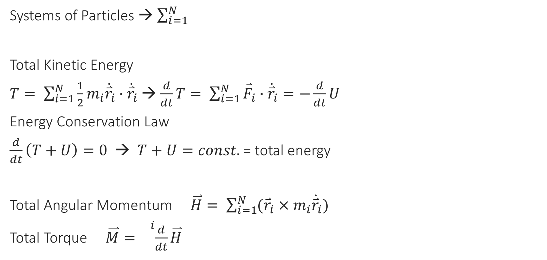
1.12 Energy for Systems of Particles 1.13 Angular Momentum for Systems of Particles
Systems of Particles → $\sum_{i=1}^{N}{}$
Total Kinetic Energy
$T= \sum_{i=1}^{N}{\frac{1}{2}m_{i}{\dot{\overset{⃑}{r}}}_{i}}∙{\dot{\overset{⃑}{r}}}_{i}$ → $\frac{d}{dt}T= \sum_{i=1}^{N}{{\overset{⃑}{F}}_{i}}∙{\dot{\overset{⃑}{r}}}_{i}=−\frac{d}{dt}U$
Energy Conservation Law
$\frac{d}{dt}\left(T+U\right)=0$ → $T+U=const.$ = total energy
Total Angular Momentum $\overset{⃑}{H}= \sum_{i=1}^{N}{({\overset{⃑}{r}}_{i}×m_{i}{\dot{\overset{⃑}{r}}}_{i}})$
Total Torque $\overset{⃑}{M}= {}_{}^{i}{\frac{d}{dt}\overset{⃑}{H}}$

Slide 10

문제1 (Prob.1)
$R^{si}= \left(\begin{matrix}\cos{wt} & \sin{wt} \\ −\sin{wt} & \cos{wt}\end{matrix}\right)$
${({}_{}^{i}{\frac{dr}{dt}})}^{i}= R^{is} {({}_{}^{i}{\frac{dr}{dt}})}^{s}$

Slide 11

문제2 (Prob.2), 문제4 (Prob.9), 문제5 (Prob.5)
Velocity Rule
${}_{}^{i}{\frac{d\overset{⃑}{r}}{dt}}={}_{}^{s}{\frac{d\overset{⃑}{r}}{dt}}+ {\overset{⃑}{w}}^{si}×{\overset{⃑}{r}}^{s}$
${}_{}^{i}{\overset{⃑}{a}}= {}_{}^{i}{\frac{d^{2}}{{dt}^{2}}}\left(\overset{⃑}{R}\right)+{}_{}^{s}{\frac{d^{2}}{{dt}^{2}}}\left(\overset{⃑}{r}\right)$
$+2{\overset{⃑}{w}}^{si}×{}_{}^{s}{\frac{d\overset{⃑}{r}}{dt}} + {}_{}^{s}{\frac{d}{dt}}{\overset{⃑}{w}}^{si}×\overset{⃑}{r} + {\overset{⃑}{w}}^{si}×({\overset{⃑}{w}}^{si}×\overset{⃑}{r})$

Slide 12

문제3 (Prob.4)
${\overset{⃑}{w}}^{si}= \dot{δ}\hat{s_{1}}+\left(w+\dot{λ}\right)\hat{i_{3}}$
$\hat{i_{3}}=sinδ \hat{s_{2}}+cosδ \hat{s_{3}}$
Velocity Rule ~

Slide 13
문제6 (Prob.6)
Velocity Rule
Low gravity → acceleration ~ 0

Slide 14
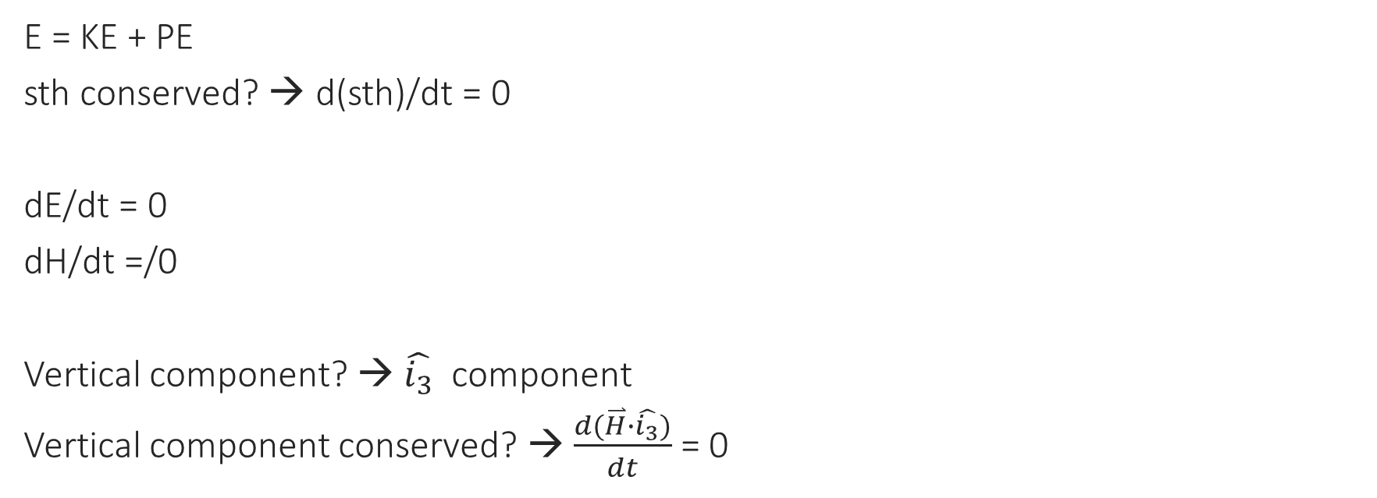
문제7 (Prob.10)
E = KE + PE
sth conserved? → d(sth)/dt = 0
dE/dt = 0
dH/dt =/0
Vertical component? → $\hat{i_{3}}$ component
Vertical component conserved? → $\frac{d(\overset{⃑}{H}∙\hat{i_{3}})}{dt}$ = 0

